Slide 1


Team 29: Shoe AR
Bi-Weekly Update 5 Santiago Cantu, Alvaro Espinoza, Ulises Aguilera, Brandon Smith Sponsor: Pranav Dhulipala TA: Eric Robles

Slide 2

Executive Summary
Problem Statement:
Online shopping has no manner of ensuring the correct size
No way of seeing how a shoe looks on your foot
Our App Will:
Measure the size of your foot and provide you with the correct shoe size
Provide a live visual of how the shoe would look on your foot

Slide 3
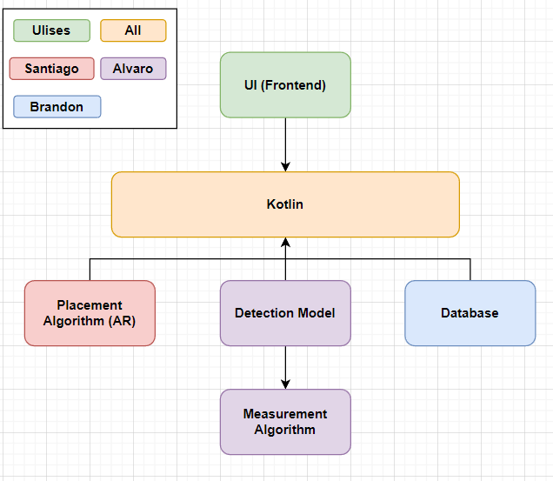
System Block Diagram
UI:​
Storefront
Camera
Kotlin:​​
Information transfer
Database:​
Shoe models
Placement Algorithm:​
Superimposition
Detection Model:
Foot Detection​
Measurement Algorithm:​​
Foot size

Slide 4
Project Timeline
Subsystem Designs and Testing (completed 9/21) | Integration of Database with UI (to complete by 10/5) | Integration of ML Model and AR Camera with UI and Database (to complete by 10/19) | Final Integration (to complete by 10/26) | System Test (to complete by 10/30) | Validation (to complete by 11/2) | Demo and Report (to complete by 12/2)
Notes:
Eric

Slide 5
Database/Backend
Brandon Smith
Accomplishments since Status Update 4 25hrs | Ongoing progress/problems and plans until the next presentation
Cart and user framework added to the Kotlin rooms database Shoe model file path updated to match new files | Validate that all stored data for each shoe can be pulled Validate that user and cart data can be stored and edited

Slide 6
Database/Backend Brandon Smith
Shoe DB Structure
ID | Model path | Model Name | Image | Price | Info | Cart
User DB Structure
ID | Username | Password | Email | Foot Size

Slide 7
Frontend
Ulises Aguilera
Accomplishments Status Update 4 20hrs | Ongoing progress/problems and plans until the next presentation
Fully integrated with Backend Began validating backend integration Fully integrated with Superimposition Integrated with Object Detection | Complete Frontend validation Complete Superimposition validation Finish integrating Object Detection Validate Object Detection integration

Slide 8
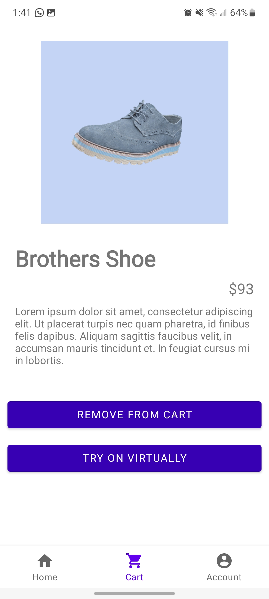
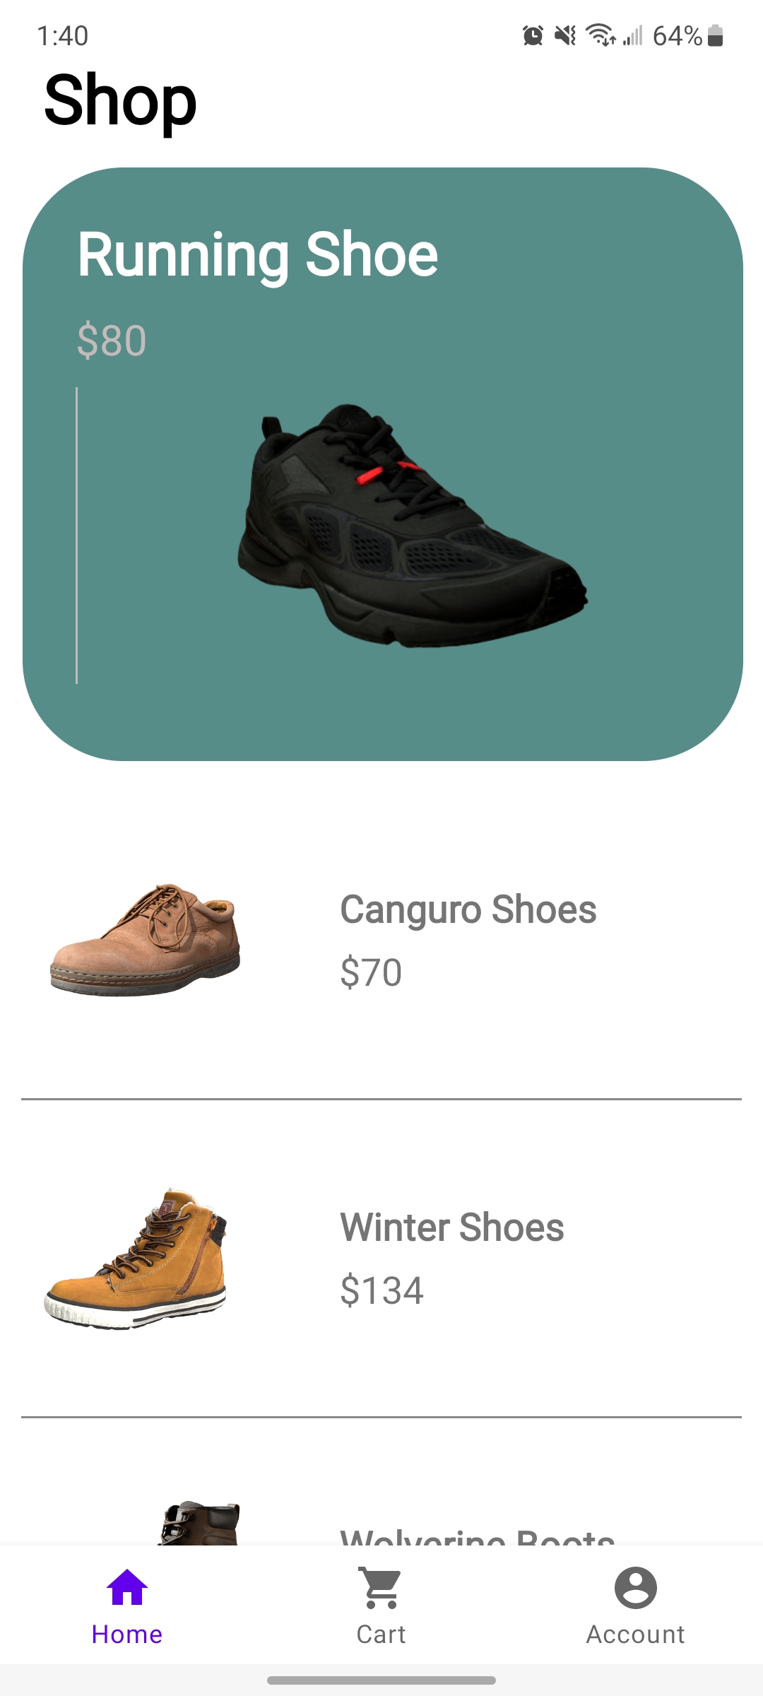
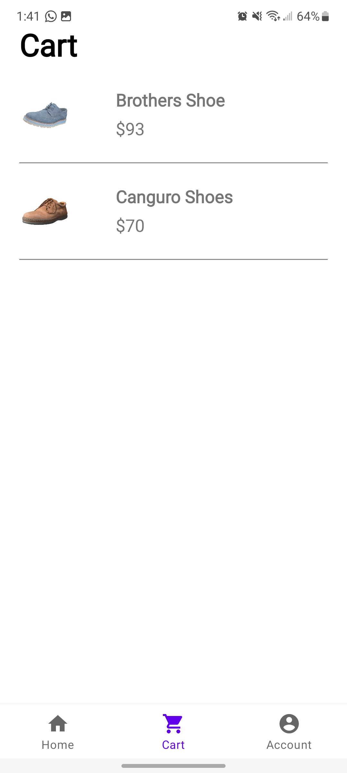
Frontend Ulises Aguilera

Slide 9
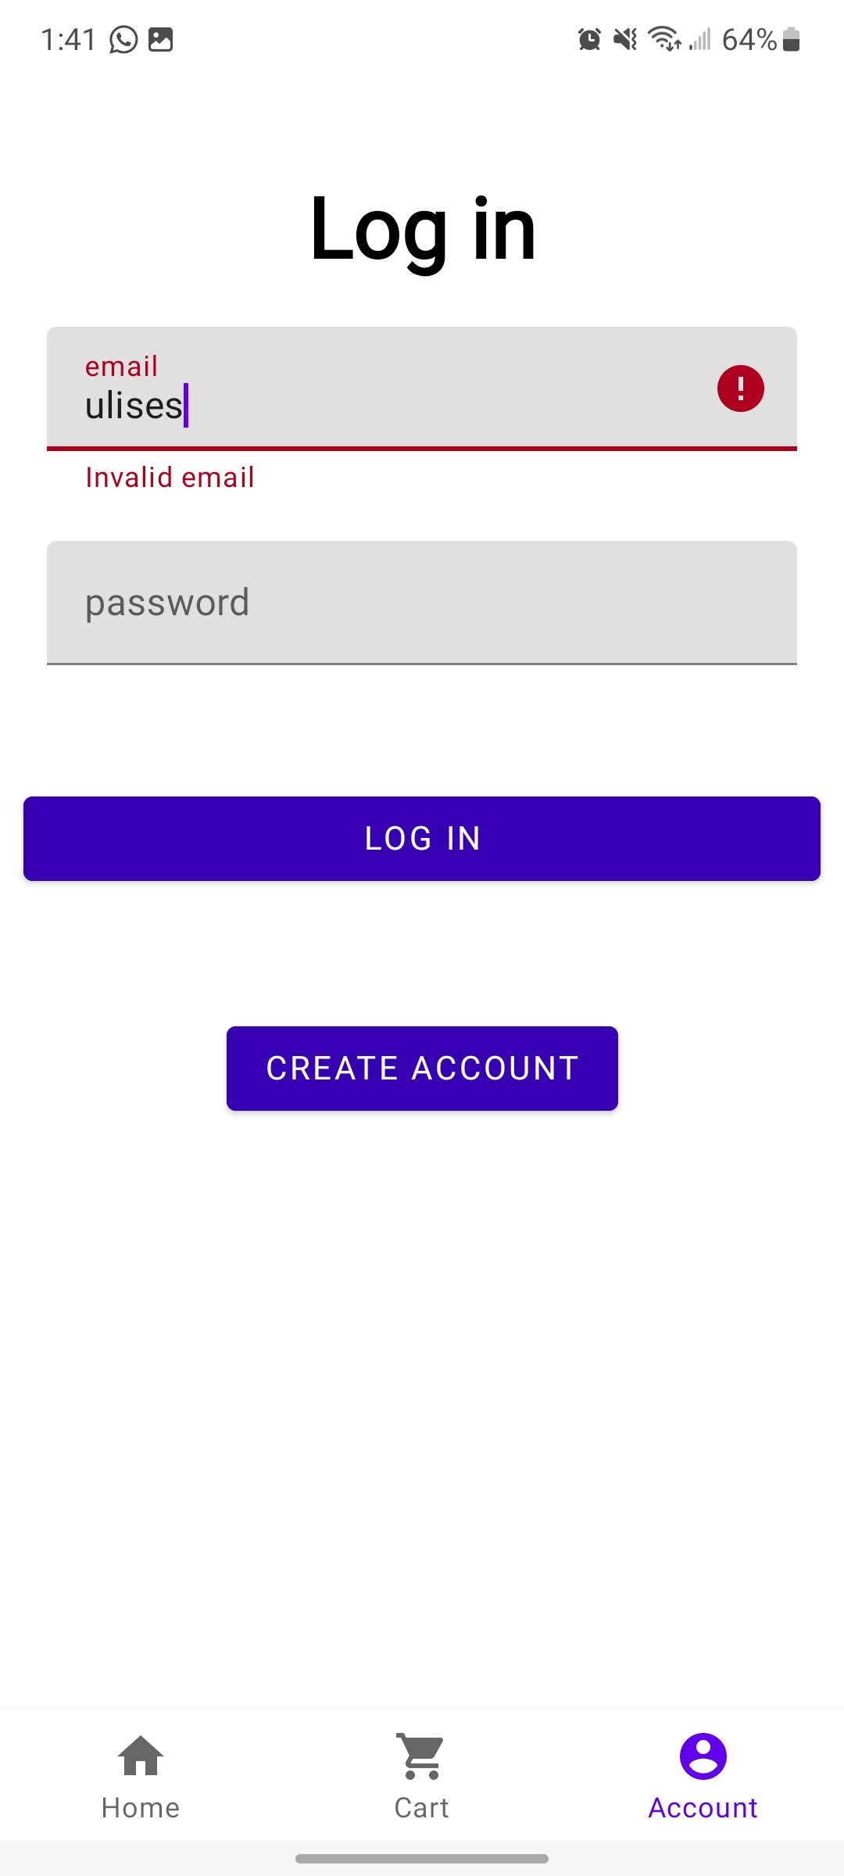
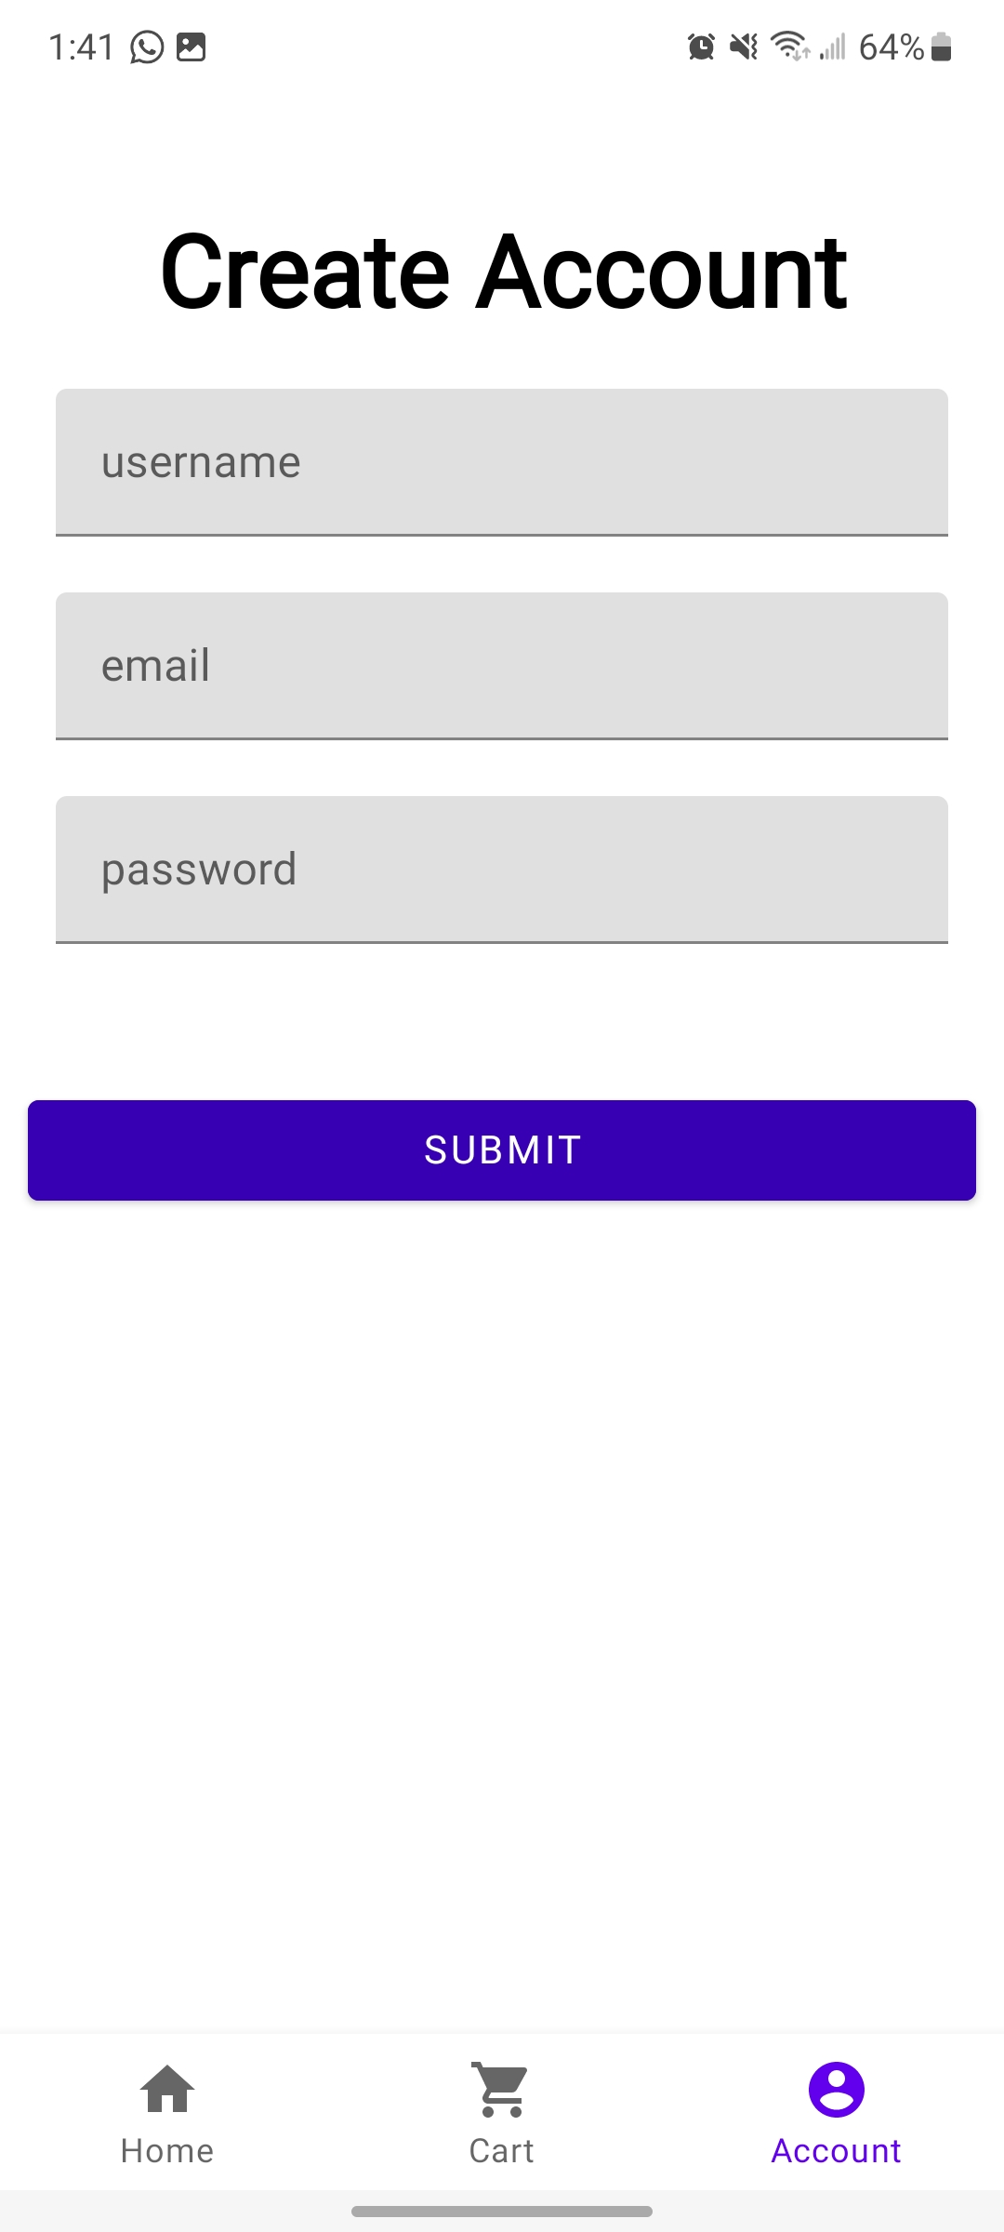
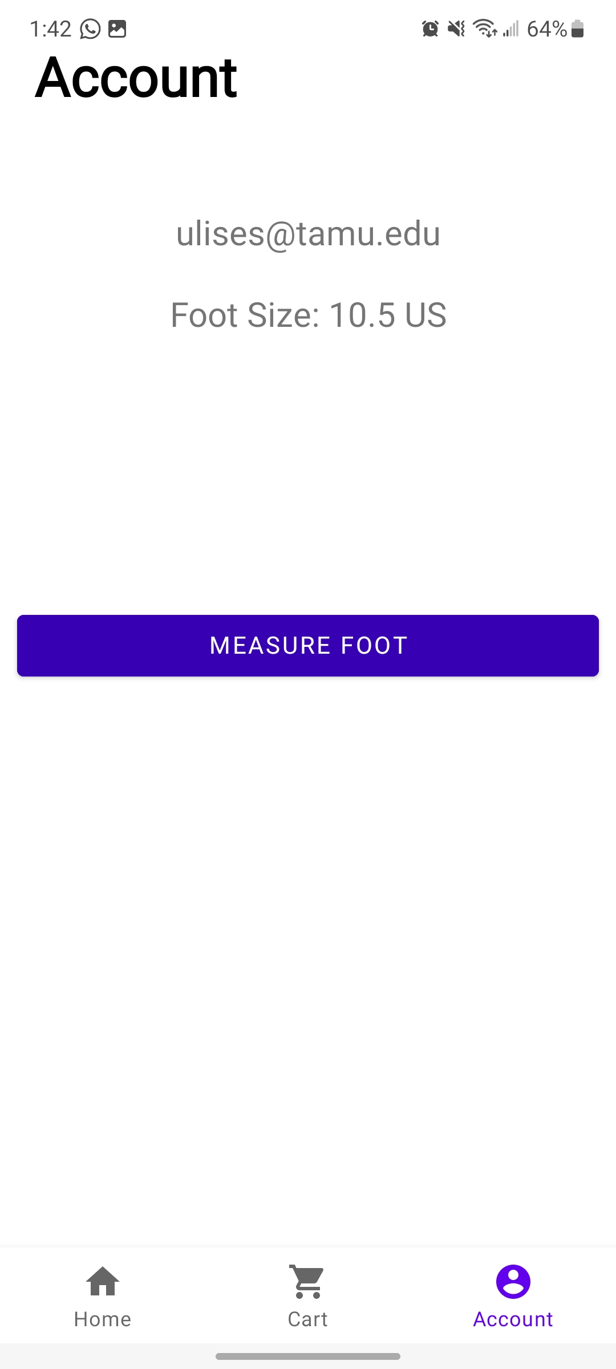
Frontend Ulises Aguilera

Slide 10
Shoe Superimposition
Santiago Cantu
Accomplishments since Status Update 4 19 hrs | Ongoing progress/problems and plans until the next presentation
Fully Integrated with Database Converted shoe files from .usdc to .glb Validated 30 correct 3D model pulls Validated Error Handling tests (camera, file availability, AR features) | Ongoing integration with Foot Detection Translating positioning data received from Foot Detection

Slide 11
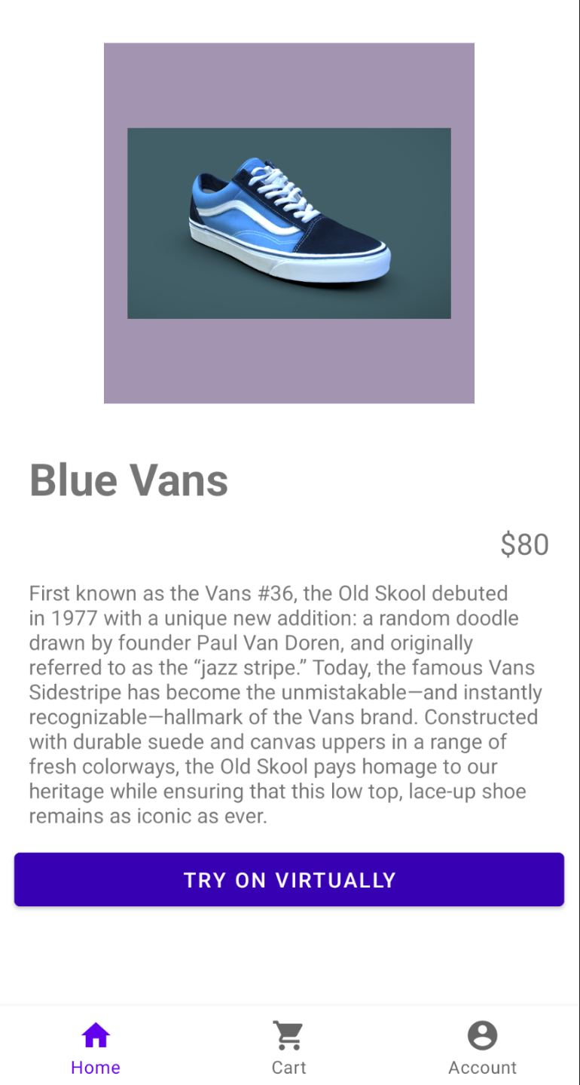
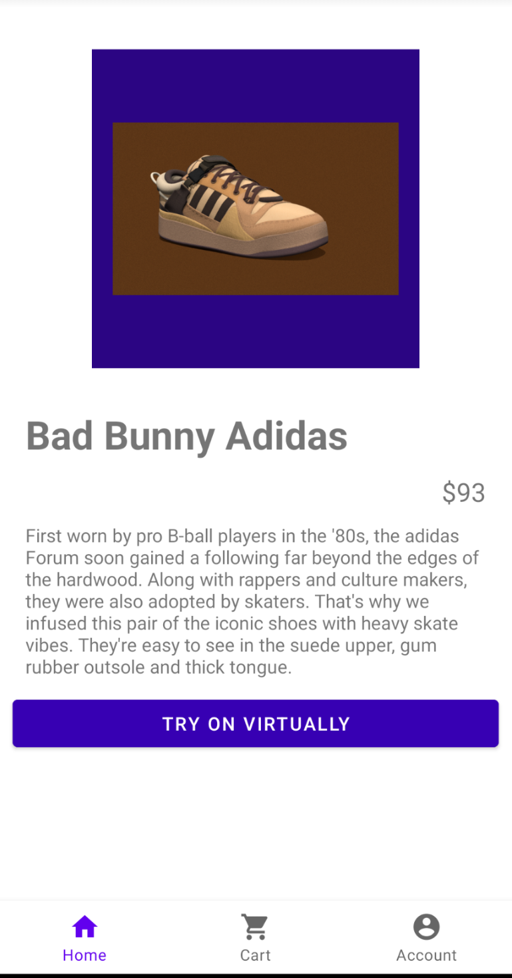
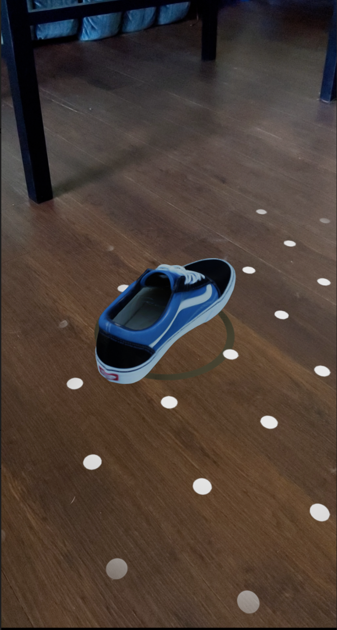
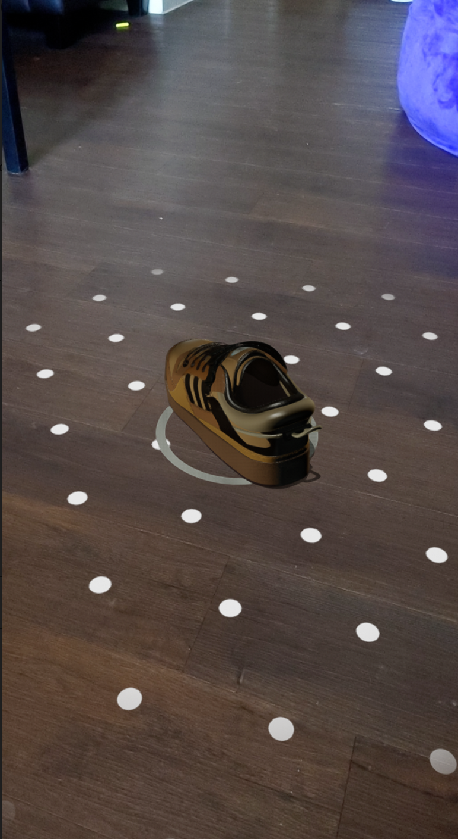
Shoe Superimposition Santiago Cantu

Slide 12
Object Detection
Alvaro Espinoza
Accomplishments since Status Update 4 13 hrs | Ongoing progress/problems and plans until the next presentation
Fully Integrated with Front End Validated test object detection in different backgrounds, lighting, and types Validated camera permissions handling | Ongoing integration with Shoe Superimposition Validate foot detection in different backgrounds, lighting, and types Validate size accuracy with different people

Slide 13
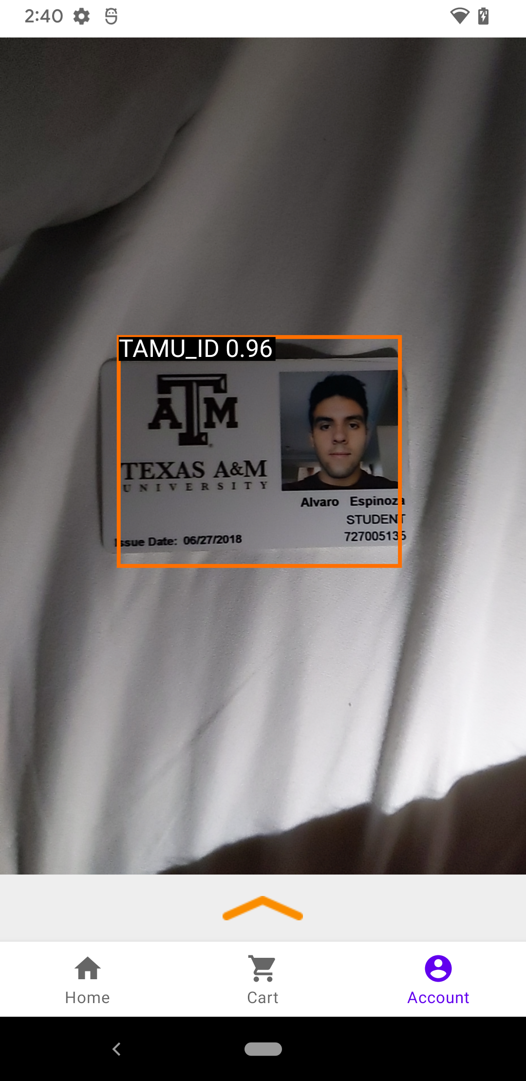
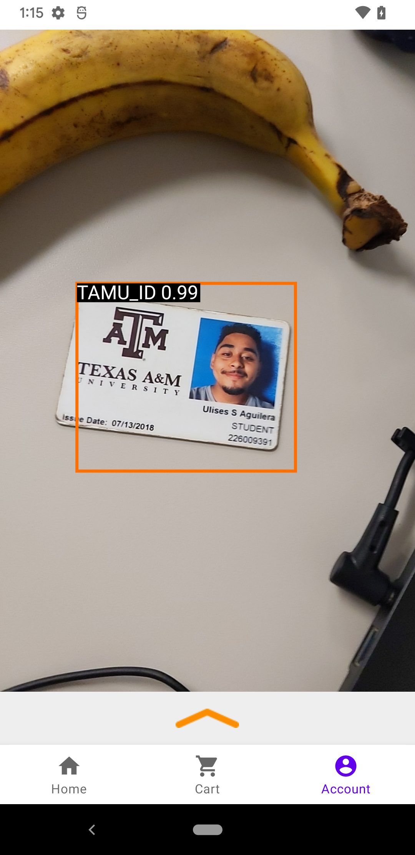
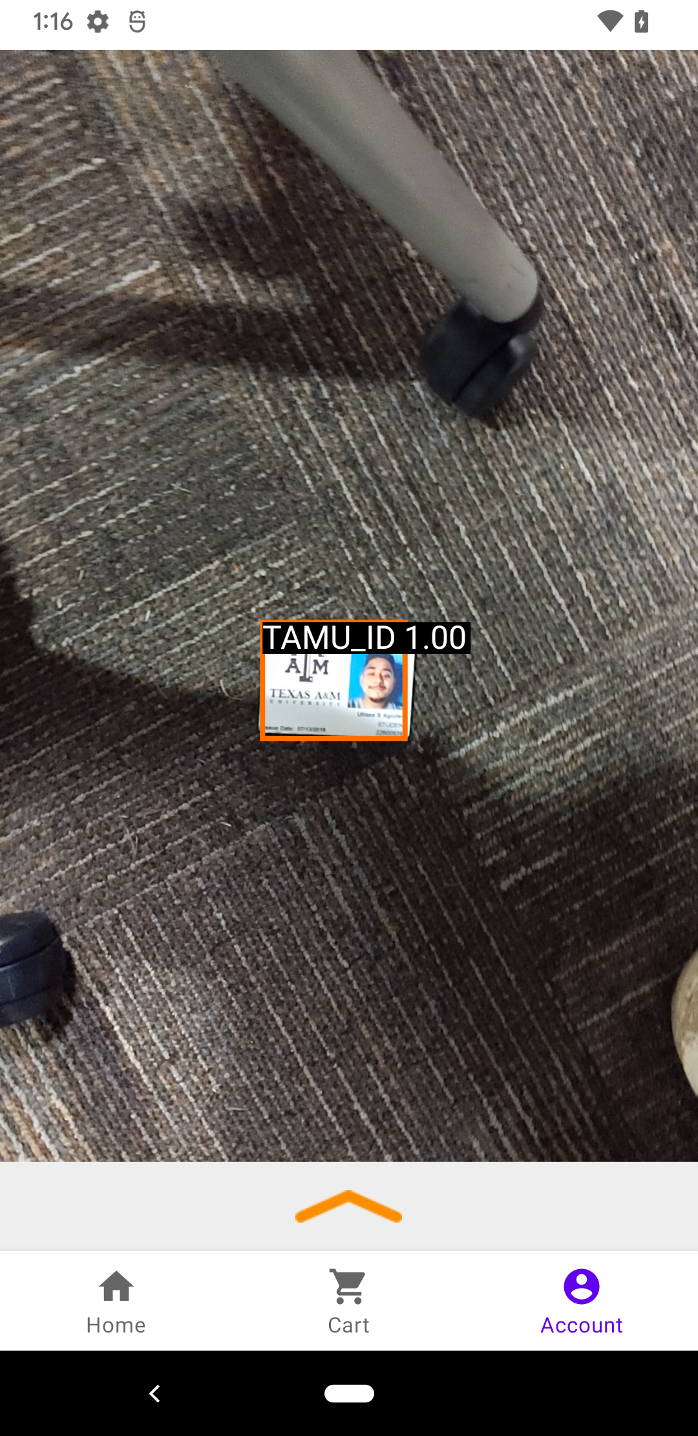
Object Detection Alvaro Espinoza

Slide 14
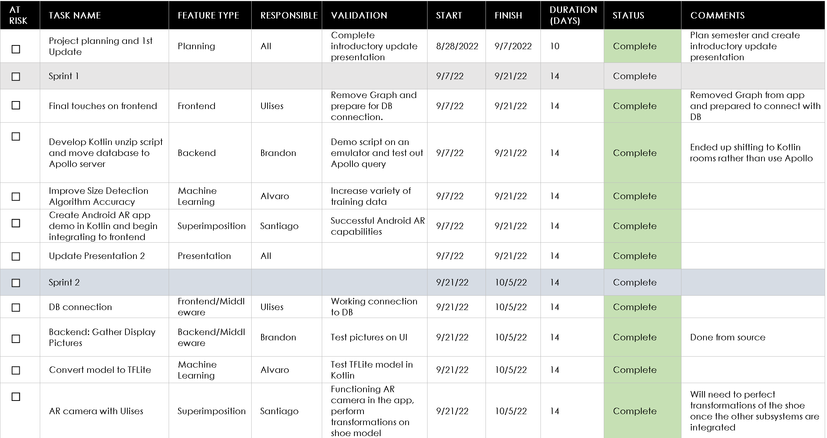
Execution & Validation Plan
Notes:
Michelle

Slide 15
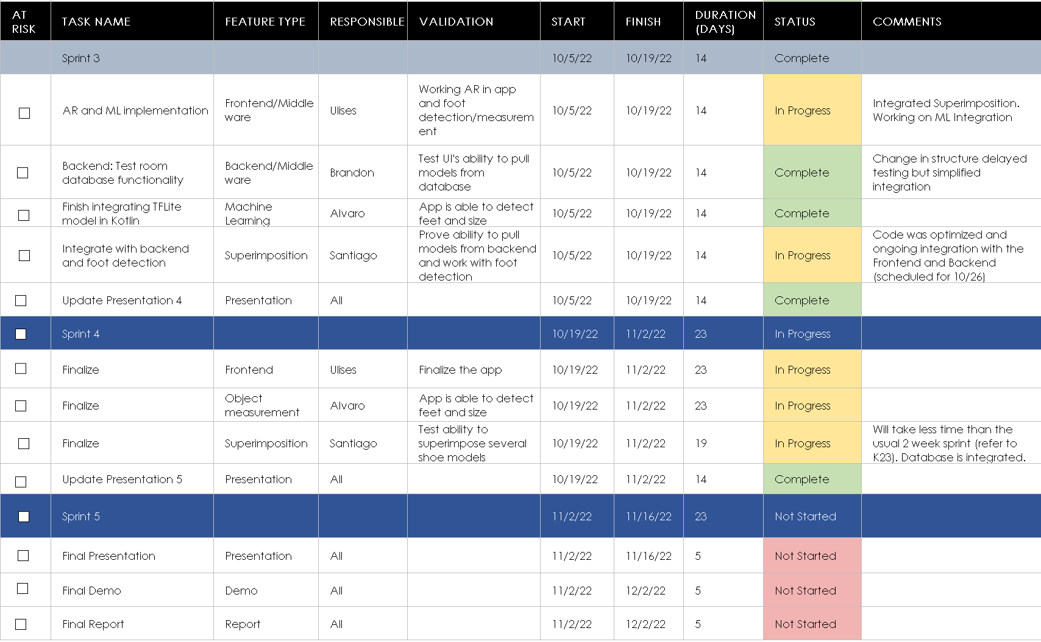
Execution & Validation Plan
Notes:
Michelle

Slide 16
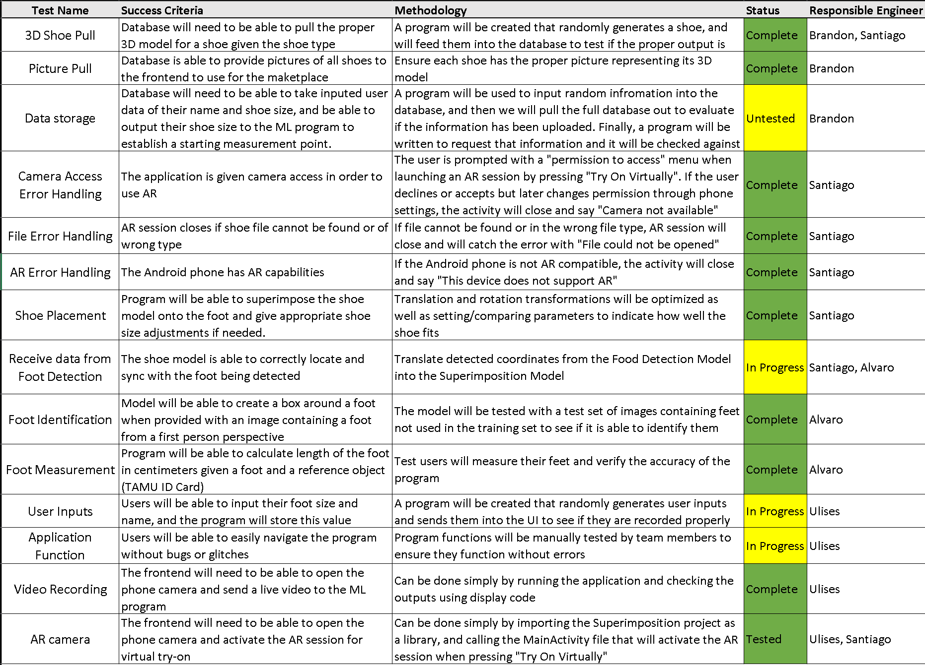
Execution & Validation Plan
Notes:
Michelle

Slide 17
Thank you!
Questions?

